Slide 1

A LAB PROJECT
On
MUSIC PLAYER
BACHELOR OF TECHNOLOGY
IN
COMPUTER SCIENCE AND ENGINEERING
BY
MOUNIKA.M(22VE1A05A1)
ACADEMIC YEAR: 2023-2024

Slide 2
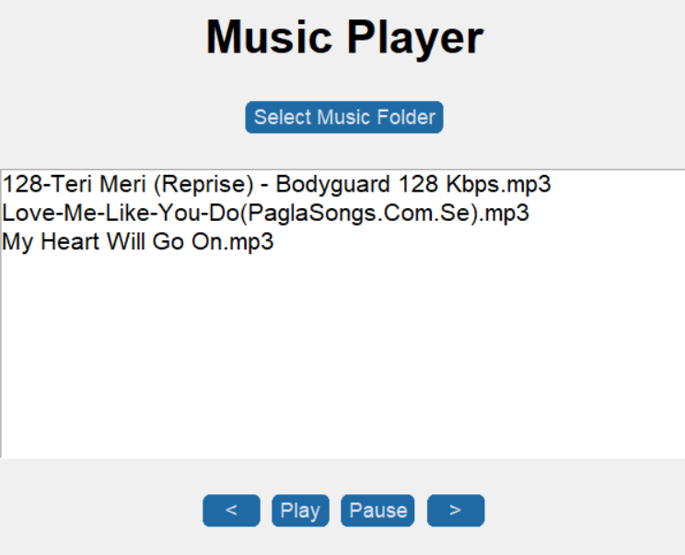
MUSIC PLAYER
CONTENTS
How does music player work?
Requirements to create music player in python
Explain the main Modules/functions/methods in the program
Python Code to create music player
Flow of the Program and Conclusion
Output.

Slide 3
How does music player work?
A basic music player allowing users to play audio files.
Functions:
Load and play audio files.
Play, pause,next song,previous song

Slide 4
Requirements to create music player in python
REQUIRED PYTHON MODULES:
Tkinter,customtkinter
Filedialog
Progressbar
Mutagen
Pygame
Os
Time
Threading

Slide 5
Main Modules/functions/methods in the program
Here the user defined main functions
def update_progress()
def select_music_folder()
def previous_song()
def next_song()
def play_selected_song()
def play_music()
def pause_music()
def stop_music()

Slide 6
Python Code to create music player
import tkinter as tk
from tkinter import filedialog
from tkinter.ttk import Progressbar
import customtkinter as ctk
from mutagen.mp3 import MP3
import threading
import pygame
import time
import os
# Initialize pygame mixer
pygame.mixer.init()
# Store the current position of the music
current_position = 0
paused = False
selected_folder_path = "" # Store the selected folder path

Slide 7
Flow of the Program
#after importing the required python modules, pygame.mixer() is initialized and current position of music is stored
#a user defined function to update progess is created
def update_progress():
global current_position
while True:
if pygame.mixer.music.get_busy() and not paused:
current_position = pygame.mixer.music.get_pos() / 1000
pbar["value"] = current_position
# Check if the current song has reached its maximum duration
if current_position >= pbar["maximum"]:
stop_music() # Stop the music playback
pbar["value"] = 0 # Reset the pbar
window.update()
time.sleep(0.1)

Slide 8
Flow of the Program
# Create a thread to update the progress bar
pt = threading.Thread(target=update_progress)
pt.daemon = True
pt.start()
#a user defined function to select music folder is created
def select_music_folder():
global selected_folder_path
selected_folder_path = filedialog.askdirectory()
if selected_folder_path:
lbox.delete(0, tk.END)
for filename in os.listdir(selected_folder_path):
if filename.endswith(".mp3"):
lbox.insert(tk.END, filename) # Insert only the filename, not the full path

Slide 9
Flow of the Program
#a user defined function to play previous song is created
def previous_song():
if len(lbox.curselection()) > 0:
current_index = lbox.curselection()[0]
if current_index > 0:
lbox.selection_clear(0, tk.END)
lbox.selection_set(current_index - 1)
play_selected_song()
#a user defined function to play previous song is created
def next_song():
if len(lbox.curselection()) > 0:
current_index = lbox.curselection()[0]
if current_index < lbox.size() - 1:
lbox.selection_clear(0, tk.END)
lbox.selection_set(current_index + 1)
play_selected_song()

Slide 10
Flow of the Program
#a user defined function to play and pause song is created
def play_music():
global paused
if paused:
# If the music is paused, unpause it
pygame.mixer.music.unpause()
paused = False
else:
# If the music is not paused, play the selected song
play_selected_song()
def pause_music():
global paused
# Pause the currently playing music
pygame.mixer.music.pause()
paused = True

Slide 11
Flow of the Program
#a user defined function to play selected song is created
def play_selected_song():
global current_position, paused
if len(lbox.curselection()) > 0:
current_index = lbox.curselection()[0]
selected_song = lbox.get(current_index)
full_path = os.path.join(selected_folder_path, selected_song) # Add the full path again
pygame.mixer.music.load(full_path) # Load the selected song
pygame.mixer.music.play(start=current_position) # Play the song from the current position
paused = False
audio = MP3(full_path)
song_duration = audio.info.length
pbar["maximum"] = song_duration # Set the maximum value of the pbar to the song duration

Slide 12
Flow of the Program
#a user defined function to play selected song is created
def stop_music():
global paused
# Stop the currently playing music and reset the progress bar
pygame.mixer.music.stop()
paused = False
# Create the main window
window = tk.Tk()
window.title("Music Player App")
window.geometry("600x500")
# Create a label for the music player title
l_music_player = tk.Label(window, text="Music Player", font=("TkDefaultFont", 30, "bold"))
l_music_player.pack(pady=10)

Slide 13
Flow of the Program
# Create a button to select the music folder
btn_select_folder = ctk.CTkButton(window, text="Select Music Folder",
command=select_music_folder,
font=("TkDefaultFont", 18))
btn_select_folder.pack(pady=20)
# Create a listbox to display the available songs
lbox = tk.Listbox(window, width=50, font=("TkDefaultFont", 16))
lbox.pack(pady=10)
# Create a frame to hold the control buttons
btn_frame = tk.Frame(window)
btn_frame.pack(pady=20)

Slide 14
Flow of the Program
# Create a button to pause the music
btn_pause = ctk.CTkButton(btn_frame, text="Pause", command=pause_music, width=50,
font=("TkDefaultFont", 18))
btn_pause.pack(side=tk.LEFT, padx=5)
# Create a button to go to the next song
btn_next = ctk.CTkButton(btn_frame, text=">", command=next_song, width=50,
font=("TkDefaultFont", 18))
btn_next.pack(side=tk.LEFT, padx=5)
# Create a progress bar to indicate the current song's progress
pbar = Progressbar(window, length=300, mode="determinate")
pbar.pack(pady=10)
window.mainloop()

Slide 15
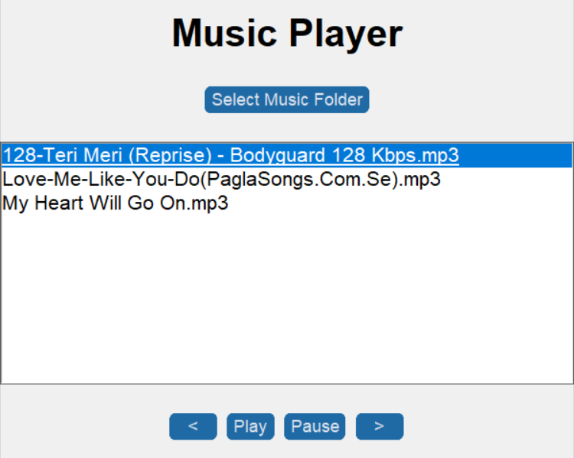
Conclusion
This creates a music player that can load, play, pause , next and back music

Slide 16
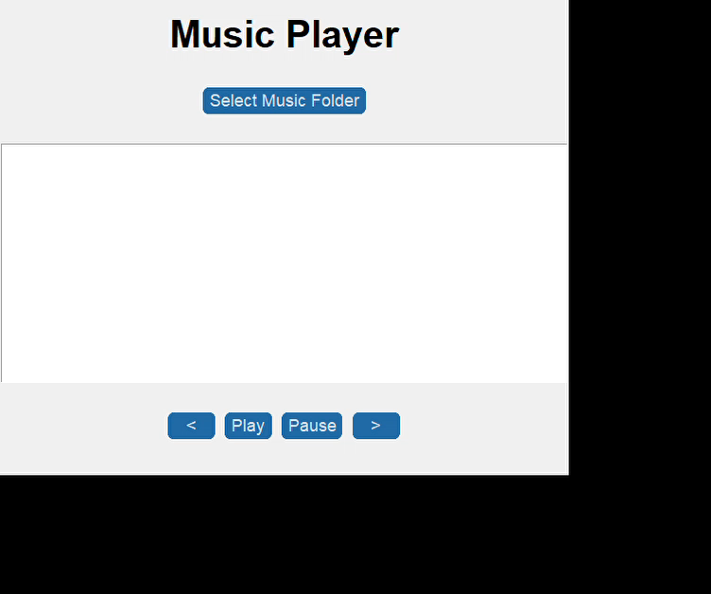

Output

Slide 17

THANK YOU

